Slide 1
Turtle Games
Insights on data analysis

Slide 2
Introduction
Turtle Games needs to improve overall sales performance
by utilizing customer trends
Understanding
How customers accumulate loyalty points
Which are the most important variables for collecting loyalty points
How customers can be clustered according to variables
Use of social data in marketing campaigns
Statistical analysis and modelling

Slide 3
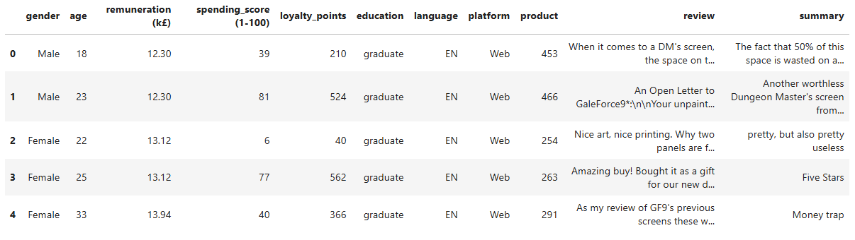
The data
Data include gender, age, remuneration (in k£), spending score (0-100), loyalty points, education, language, platform, product, review and summary

Slide 4
Loyalty points vs. variables

Slide 5
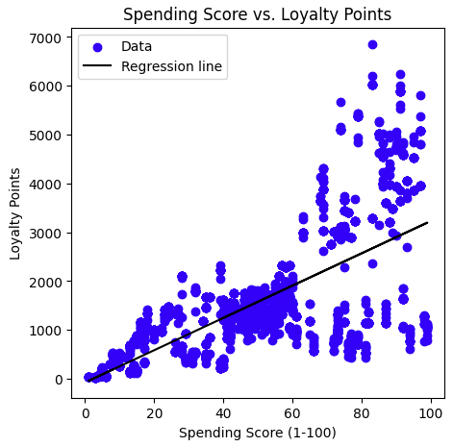
Spending score vs. Loyalty points
The higher the spending score, the higher the loyalty points.
The spread of the loyalty points increases with increasing the spending score.
A weak linear relationship between the two quantities is present

Slide 6
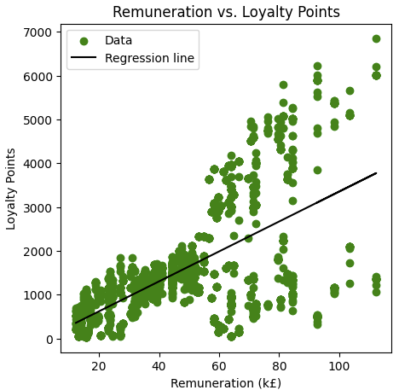
Renumeration vs. loyalty points
The higher the remuneration, the higher the loyalty points.
The spread of the loyalty points increases with increasing the remuneration.
A weak linear relationship between the two quantities is present

Slide 7
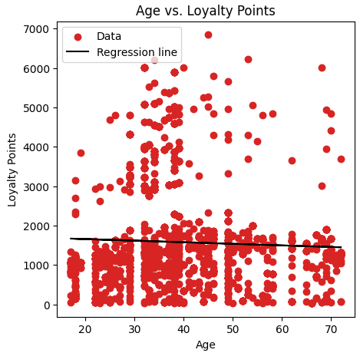
Age vs. loyalty points
The data are evenly spread across the plot.
The age is not an important variable.

Slide 8
Which variables are important?
The highest number of loyalty point is reached by people with high spending score and high remuneration.
Spending score
The highest number of loyalty points is reached with a spending score higher than 71.5
The largest group of customers (498) reaches an average of 1500 loyalty points with a spending score of 61.5.
Remuneration
The highest number of loyalty points is reached with a remuneration higher than 107830 £.
The largest group of customers (498) reaches an average of 1500 loyalty points with a remuneration higher 33620 £.
Age is not an important value

Slide 9
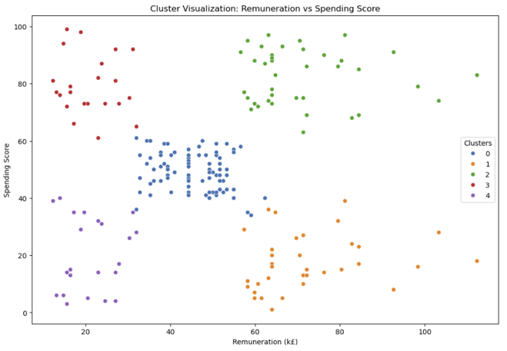
Define market segments
Customers are grouped w.r.t. spending score and remuneration

Slide 10
Define market segments
Customers with spending score between 40 and 60 and remuneration 30 - 60 k£ form the biggest cluster.
Customers with high spending scores and high remuneration.
Customers with low remuneration but high spending score.
Customers with low spending score and low remuneration
Customers with low spending score and high remuneration

Slide 11
Take away messages
Marketing campaigns should address customer with average spending scores and remuneration.
As well doing promotions towards customers with low remuneration but high spending score.
Low-spending score customers, with low and high remuneration should be the target of specific promotions, to push their spending score.

Slide 12
Customers Sentiment

Slide 13
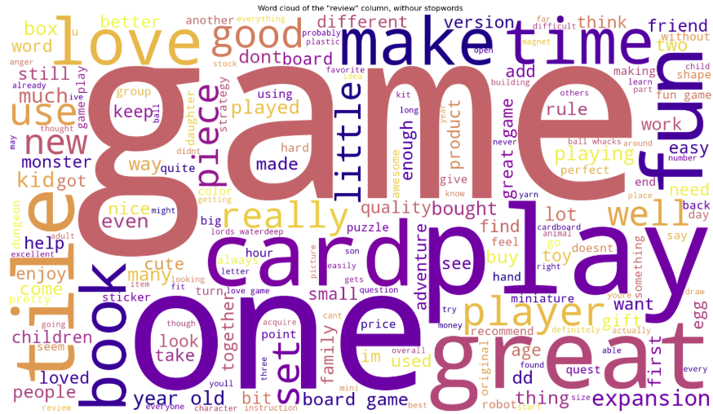
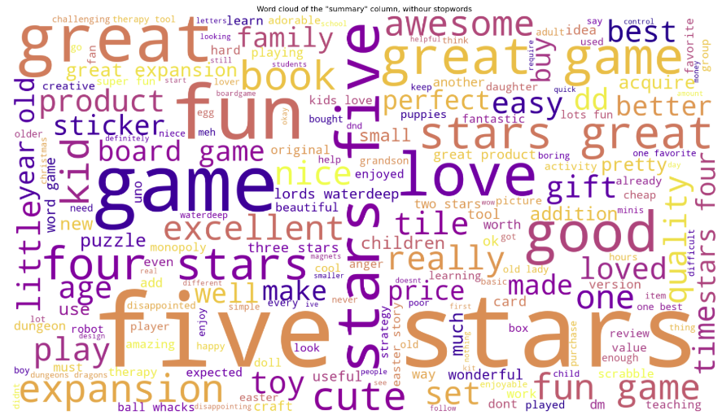
Customers Sentiment
Products reviews and summary were analysed.
Review
Summary
Notes:
In the reviews, the most popular word is "game", followed by "great", "fun", "one", "play", all positive or natural words.
Similarly, in the summaries, the most popular word is "star", followed by "five", "game", "great", "fun", still positive or natural words.

Slide 14
Customers Sentiment
The most common words are positive.
Words like game, great, fun, five, stars highlight the goodness of Turtle game work.
However, a deeper analysis is needed
of the word polarity (how many positive or negative word)
of the word sentiment (positive, negative, or neutral tone?)

Slide 15
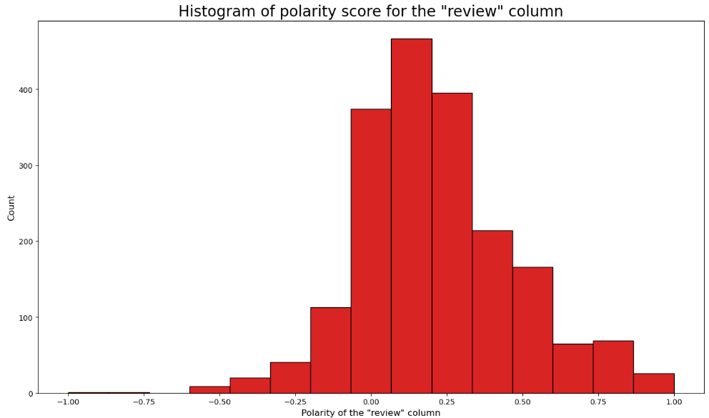
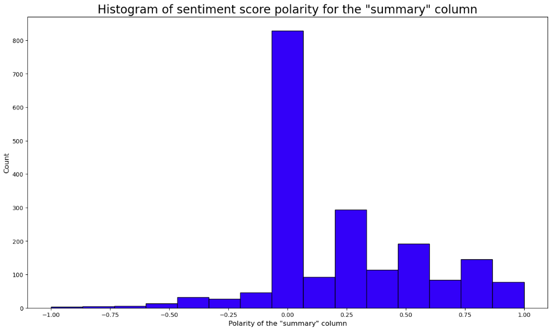


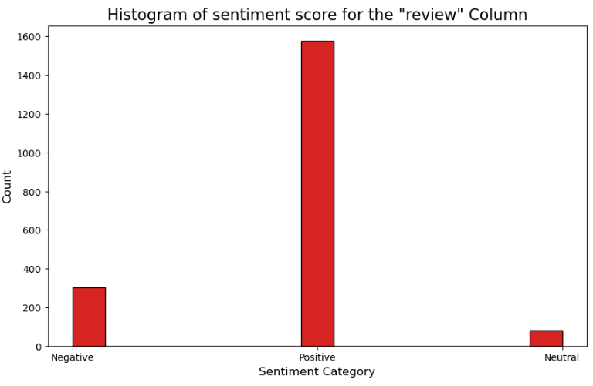
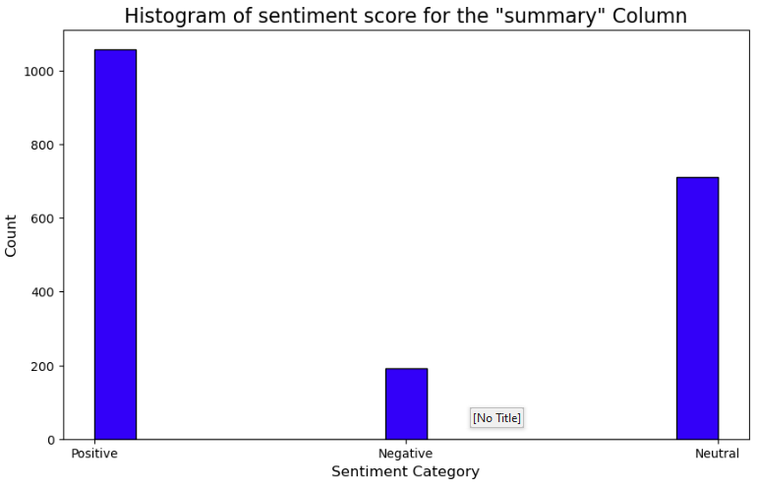

Sentiment Analysis
Review
Summary
Polarity
Sentiment
Notes:
The polarity and sentiment histograms confirm that both reviews and summaries have strong positive scores.
In the reviews, the predominancy of positive words is strong.
In the summaries, there is a high number of neutral words, but still lower than the positive ones

Slide 16
Take away messages
Turtle Games could use this positive vibe for their marketing campaigns, by adopting positive words in their commercials.
A deeper study of the negative words and their frequency could help address and improve some issues.

Slide 17
Correlation of variables
We are interested in the loyalty points variable, and how strong the other variables correlate with it.

Slide 18
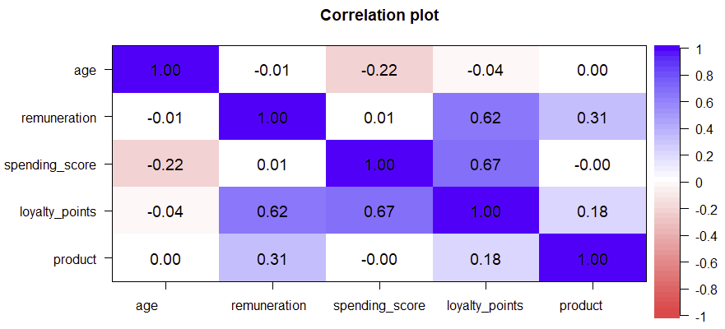
Correlation of variables
Notes:
The remuneration and spending score have a quite strong positive correlation with the loyalty points (e.g., the higher the remuneration, the higher the amount of loyalty points collected), and a weak negative correlation with the age. Here, it looks that the age is not an important factor.

Slide 19
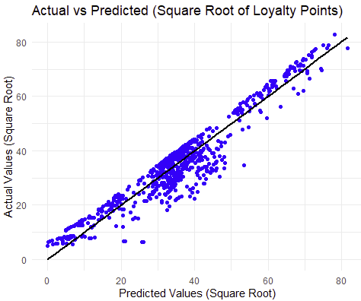
Modelling Loyalty points
A linear relation subsists between the square root of loyalty points and the variables in consideration.
Higher spending score and remuneration do not result in a similar increase of loyalty points.

Slide 20
Conclusions
Loyalty points are driven mostly by customer remuneration and spending score
Not by age
Most of customers have an average remuneration and spending score
But Turtle games could benefit from targeted marketing campaigns towards other groups
Customers show positive sentiments towards Turtle game’s products
However, further studies are needed to address the causes of negative and neutral sentiment

Slide 21
Thanks for your kind attention

